Slide 1
Financial, Retirement
& Healthcare Planning 101
Presented By:
Bart Francescone

Slide 2
InFaith Retirement Plan
401(k) Defined Contribution Retirement Plan
Some Basics, What You Need to Know & Do
Financial Planning & Advising Services, Withdrawing
Communications
& Member Services

Slide 3
InFaith 401(k) Retirement Plan
401(k) Retirement Plan
Unlike a pension plan you own the account
You choose & control where your money is invested
First Time Enrolling
Complete new user registration and make your investment choices
Notify InFaith that you are ready to go
You can “roll in” funds from another retirement plan (IRA, 403b, 401k, etc.)
From your salary you can contribute a fixed amount each pay period or a percentage to your retirement account. InFaith will match your contribution up to 3% of your salary

Slide 4
Managing/Updating Your Retirement Account
Your InFaith Retirement account is held at Fidelity Investments
Log onto your account at: www.netbenefits.com/
Check your balances, earnings and transaction records
CHOOSE or CHANGE the Funds where your money is invested at any time. You can do this for both new funds going in and for existing funds already in your account.
Check or change your beneficiary(s)!!!
Check or update your personal information
Reset your password
Secure your account and protect your savings:
Provide Fidelity with your contact information
Set up two-factor authentication
Set up MyVoice phone authentication
Enroll in eDelivery enabling real-time alerts

Slide 5
Help With Choosing & Managing Your Investments
Read the Enrollment & Investment Guide provided by your Plan Recordkeeper Fidelity.
Where should I invest my retirement money?
Placing your retirement money in one of 14 “Target Date” Funds
Choose the date closest to your expected retirement year and put some or all of your money there
Or:
Choose a mix from 17 Core Asset Class funds
Or:
Blend a portion in Target Date and Asset Class funds

Slide 6
More Help with Managing Your Investments
Meet with a licensed Fidelity Investment Adviser
Contact Fidelity as often as you want at no cost to you and set up an appointment to meet with an Investment Adviser. Call Adviser Help Desk 833-349-6757, enter Plan #44686, ask for Advisor Help Desk
Consider making pre-tax deferral contributions known as “Roth” contributions. (Pay taxes now instead later in life of when you withdraw it.)
Participant Help Desk: 800-835-5097. Your Plan number is 44686
Can’t seem to remember that Finance Course you took while training for your ministry? The Risk – Return Spectrum? Asset Class Choices?
Crash Course Follows:

Slide 7
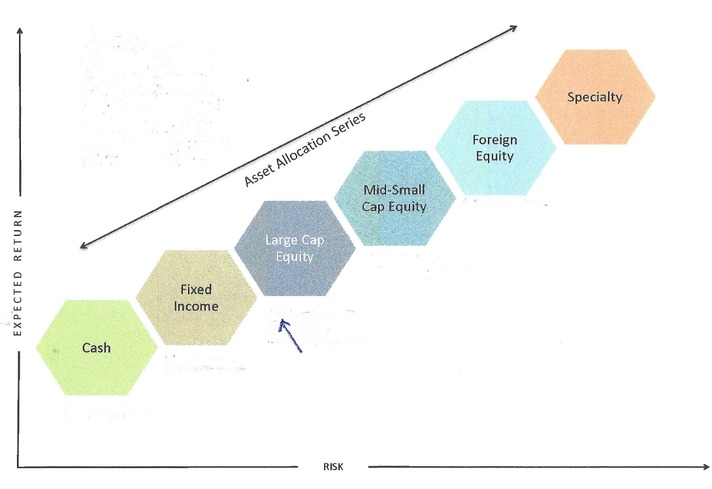
Investment Choices – Asset Classes – Risk Profile

Slide 8
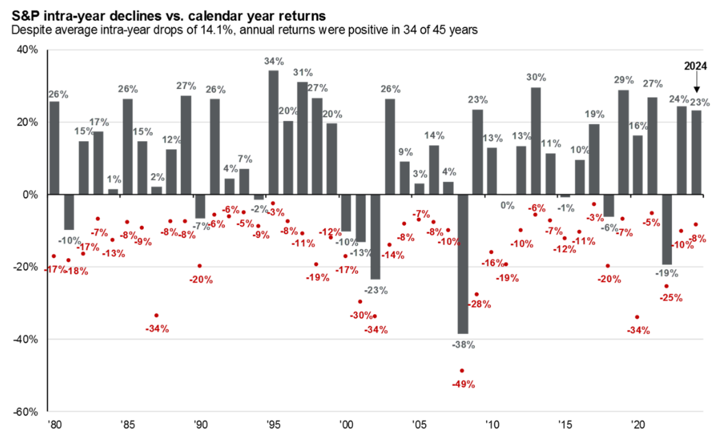
Annual Returns and Intra-Year Declines Since 1980
Source: FactSet, Standard & Poor’s, J.P. Morgan Asset Management.
Returns are based on price index only and do not include dividends. Intra-year drops refers to the largest market drops from a peak to a trough during the year. For illustrative purposes only. Returns shown are calendar year returns from 1980 to 2024, over which time period the average annual return was 10.6%.
Guide to the Markets – U.S. Data are as of December 31, 2024.

Slide 9
Participant Resources
Online Learning Hub at Fidelity
Participants have 24/7 access to a collection of resources and interactive tools
Educational Videos
Inflation Tips
Student & Credit Card Debt
Improving Your Credit Score
Why Should I Save for Retirement in My Twenties?
Creating a Spending & Saving Plan
Ways to Improve Your Budget
What is Compounding Savings
Difference between Pre-Tax vs. Roth Contributions
Make the Most of Your Retirement Savings
Why You Need a Beneficiary
Articles
Workshops
How to pay off student loans
How much should I save for retirement
Caring for a child with special needs
How to save for emergencies
Manage your budget during times of inflation
Choose a live workshop or watch on-demand
Get started and save for the future you
Managing my money
Basics of social security
Make the most of your retirement savings
Organize, plan and own your
Fundamentals of retirement planning
Webcasts
Other
Always available, one-stop shop for past, present, and future webcasts
Interactive Tools
Life Event Resources
Handbooks & Guides
Protecting yourself in a digital world
Are you emotionally ready to retire
Fidelity Viewpoints Market Sense*
Live & On-demand 20 minute webcasts featuring the latest market happenings, conditions and what it all means to you.
When should I apply for social security
Required Minimum Distribution Calculator
Calculate the impact of changing your retirement contribution
Calculate your take-home pay based on your retirement contribution
Financial Wellness Checkup
Questions? Call Fidelity at 800-835-5097
Your Retirement Plan ID #44686

Slide 10
“Investing” Resources
You have access to an array of resources to help you with understanding the
basics of Investing. Here’s a listing of some Fidelity resources:
Live Virtual Workshops
Videos
Articles
Choose a live workshop or watch on-demand
Learn to Invest
Building a sound investment strategy
Investing basics: How to prioritize your debt
Invest confidently for your future
Learn investing basics
How do I know if I have the right investment mix
What are the biggest investing pitfalls to avoid?
What is a target date fund?
Investing basics
Types of accounts and investments
Getting started investing
Habits of successful investors
What is…
Investing
Stocks
Mutual funds
Investing for beginners
Take the first step to investing
Invest confidently for your future
Navigating Market Volatility
Quarterly Market Perspective
Questions?
Call Fidelity at 800-835-5097
InFaith Retirement Plan ID #44686

Slide 11
Building Your Retirement Savings
How much can I contribute?
Employee and employer matching contributions
Regular and catch-up contributions for those over 50
Do I pay taxes on amounts contributed? No, except for Roth contributions
Move existing balances and/or new contributions to different funds at any time
At age 59½ you can begin making withdrawals without paying a 10% penalty, but you must pay federal income taxes
Are there provisions for withdrawing sooner without penalty? Not presently, but recent legislation does allow for “hardship withdrawals” for certain reasons without penalty. These may be allowed by your plan in the future.
What if I must take money out for another reason before I’m 59½?
If you do, you pay a 10% penalty plus the income tax.

Slide 12
Withdrawing Funds form Your Account
Can I take out a Loan from my Account?
Yes, you can. Fidelity will manage this process. You pay a fee and interest on the loan until you repay it. There are limitation on amounts and frequency.
Making Withdrawals after age 59½
For Housing Expenses (Ordained ministers only, may be exempt from paying federal income taxes.)
For Other Needs/Expenses, Requested Minimum Distributions(RMD), etc.
Withdrawal tools available administered by Fidelity
Use forms provided on Fidelity Website at your NetBenefits account log in
Traditional & Automated Methods:
“Fixed Amount” paid periodically or for a specific timeframe.
“Life Expectancy” based
Annualized “Fixed Percent”

Slide 13
30%+ of adults in the USA are likely to have this condition __________ _______.
diabetes / prediabetes
This condition is one of the most prominent amongst our participants _______ _______.
chronic pain
This common chronic condition is known as the “Silent Killer” _______ _______ ________.
high
blood
pressure
There is a _______ _______. crisis in our nation.
mental health
You should be concerned about cyber security & the _______ _______.
dark
web

Slide 14
Are YOU Taking Care of Yourself ?
Are you being deliberate about your own care?
Are you exercising? Watching what you eat?
Getting annual physicals & cancer screenings?
Managing that chronic condition?
Do you have a primary care physician?
Actuarial Analysis

Slide 15
Hospital Specialty’s
Actuarial Analysis

Slide 16
Selecting the Right Doctor
Actuarial Analysis

Slide 17
IMPORTANT - Wide Price Variability
Actuarial Analysis

Slide 18
IMPORTANT – Wide Price Variability
Actuarial Analysis

Slide 19
Your Health - Where do you go from here?
Healthy Lifestyle Plan
Make a plan, set goals and dates, be intentional !
Close the Gaps in your Medical Care!
Eat Better
Exercise Regularly
Partner with someone for accountability
Support one another’s mental health - Love and Care for one another!
Be Engaged with a Primary Care Doctor
Get your annual physical
Get your age-appropriate annual screenings* Over 55? You need to focus on this!
Sign on and access your Meritain Health Account. Use our care programs
Actuarial Analysis

Slide 20
Typical Top 5 Drug Classes I By Frequency
Actuarial Analysis

Slide 21
Mental Health Crisis = Ministry Opportunities?
Behavioral & mental health diagnosis and treatments have grown exponentially in the past few decades.
1 in 4 in a typical U S medical benefit today are impacted… including children!
This statistic is similar in Christian organizations… so, those proclaiming Christ are no different in this challenge?
Medical plans cover mental health services, but there is a shortage of providers, and many counsellors do not accept insurance.
Are there solutions lying outside of a medical response?
Be deliberate in caring for one another. Spread the peace of Christ “that surpasses all understanding.” His flock needs healthy shepherds and ministry staff!
What are the ramifications of this mental health crisis when it comes to your ministry? Does this epidemic open a door for the Gospel?

Slide 22
Withdrawing Funds for Housing
Expenses after Reaching 59½
Available to Ordained Clergy Only based on IRS regulations
Frequent Questions:
Who determines the amount I’m allowed to designate & withdraw as Housing Allowance – You do!
Who determines whether or not federal income taxes will be withheld by Fidelity – You do!
When I make a withdrawal how do I designate whether-or-not it is for Housing Allowance so it is not taxed upon withdrawal? You need to notify Fidelity when withdrawing; or be refunded taxes when declaring it on your tax return.
What if I’m still receiving Housing Allowance through my ministry? You can’t do both and exceed the actual housing expenses allowed.

Slide 23
Withdrawing Funds for Housing
Expenses after Age 59½
How do I figure out how much is allowed and how much to withdraw during each year?
The amount you may designate and withdraw annually that is not subject to tax is the least of:
Amount designated by your Plan. (Typically up to 100% up to 100% may be used)
Amount actually spent to provide the home
Fair rental value of home including furnishings and utilities

Slide 24
Withdrawing Funds for Housing
Expenses after Retirement
More Questions:
What if I withdraw too much or too little? (It will be resolved when you file your tax return.)
Does it matter if the original contributions came from my employer or from my personal withholdings? (No, it does not)
What if funds were transferred into my InFaith plan from a prior retirement plan that was not qualified for the housing expense exemption? (If not originally from a qualified plan the funds will not qualify as tax exempt if used for housing expenses.)
Can I roll my InFaith retirement funds into an IRA or other non-qualified plan and still designate withdrawals as housing allowance? (NO, once rolled out they no longer qualify for the housing expense tax exemption!)

Slide 25
Items Considered as “Housing Expenses”
Mortgage Payments
Down payment, closing costs (NOT purchase price)
Rent
Real estate taxes
Home/renter’s insurance
Homeowner’s association dues/condo fees
Home improvements
Structural maintenance and repairs (roof, paint, deck)
Upkeep of home and contents
Utilities: heat, electric, water, sewer, garbage, gas, internet, cable
Furniture, appliances
Pictures, rugs, bedding, towels, household supplies
Yard care equipment, supplies, services, pest control

Slide 26
Cyber Security
Email Safety – Protecting Yourself
Be cautious of emails or texts that are unexpected – particularly those that are asking for you to do something right away such as:
Retrieve a voicemail or fax
Cancel an order you didn’t place or get a refund you didn’t expect
Renew a software license claiming its about to expire
Check new findings discovered from recent bloodwork
*They are often ploys to steal one of your online passwords (Microsoft, Email, Banking, Retirement Plan, etc.)
Be careful of emails that don’t look or read right:
Return email address looks wrong (i. e. support@microsoft.com is probably okay, but Microsoft_support123@gmail.com is fake)
Improper grammar or mistakes, particularly from corporate emails
A friend or co-worker asking you to do something unusual like buy them a gift card via email instead of asking in person or via the phone
Any email asking for things like account numbers, passwords or other sensitive confidential information like SSN, drivers license, etc.
Don’t click on links embedded in emails or texts unless you know they are good. Instead do a search to find the actual website of the vendor identified and go directly to or type that address into your browser. Or use a bookmark or favorite that you’ve previously saved.
Reset your password immediately if you feel you may have fallen for one of these tricks to steal your password. It usually takes hours or days before a stolen password is used, so you can minimize the risk by changing your password.
If something feels wrong, but you’re unsure if it’s a scam, reach out to the sender directly. Call on the phone to confirm; or send them a new (not reply) email to a known email address. Ask them to verify the legitimacy of the email or text you are uncertain about before acting. Or separately login to your account with that organization to see if there is a message there for you.
Use Multi-Factor Authentication (MFA) for sensitive and important accounts such as banking, retirement, healthcare. This further protects those accounts in the event a password is compromised. It is not always convenient, but it adds an extra lock on the door to your information.

Slide 27
Cyber Security
Watch out for the latest tech support and computer virus scams
Scammers pretend to be tech support from a well-known company. They either call, text or try to trick you into clicking on a link in an email, text, or pop-up window, claiming there’s a problem with your computer like a virus or a billing issue. To fix it, you inadvertently give them remote access to your computer.
Help protect yourself
Scammers know “virus alerts” immediately put computer users into a panic. Never click on virus alerts, even if they look like they come from your computer company or an anti-virus protection company. If you think your computer was impacted, talk to a reputable service provider.
Be cautious of “pay yourself” scams.
Your bank will never ask you to send money to yourself through wire transfer or finance apps such as Venmo® or Zelle®. Once you send money to a scammer, you will likely never get it back!
Spoofing: Look out for scammers in disguise.
Scammers can "spoof" phone numbers. The caller
ID can say the call or text is from a trusted contact such as your bank even though it's not. They do this to trick people into providing their personal or financial information or to get you to send money.
Remember:
Even if your caller ID says a call or text is from your bank, or credit card company, or Apple, or Microsoft, it is likely a scam. When in doubt hang up and call the institution directly.
QR Codes
Look at a QR Code before you scan. Is it the original? Is there a fake sticker on top of the original? Is the source reputable? Scammers can hide harmful links in QR codes that contain malware that take you to fake sites that steal your information
Too good to be true?
Were you offered a free product, ‘get rich quick’ opportunity, or ‘prize’ money from something you don’t recognize and weren’t expecting? If something sounds too good to be true, it probably is. Never cash a check from someone you don’t know.

Slide 28
Retirement - What Will It Be for You?
I’ll just be changing what I do
When I’m not working anymore
It happens because:
I’ve reached my “full SS retirement age”
I’m just burned out!
I have grandchildren
When both my spouse and I…

Slide 29
Retirement - Things to Consider
Social/Emotional
Work fulfillment, where is your identity, what am I going to do?
Aspects
of retirement to consider
Financial Considerations
Medical costs, housing, food, transportation, leisure, giving
Healthcare/Medical, long-term care
Setting a target date
Will you phase out of working?
Reduced hours, mentoring, etc. or just stop?

Slide 30
Retirement - Planning Ahead
The month you turn 65 you are eligible for Medicare benefits
Milestones along the way to consider
When you are eligible for full Social Security Benefits (year of birth dependent, usually 66 or older)
Will you retire based on…
your own timetable?
government provided benefits eligibility?
When you have “enough” saved?
Required Minimum Distribution (RMD) is now 73* (Not required for Roth accounts)*

Slide 31
Questions?
Thank You

